Slide 1


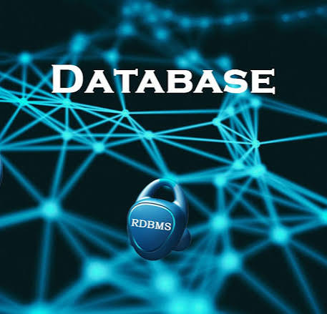

SUMMER
TRAINING
Presented by: Esraa Fathy

Slide 2
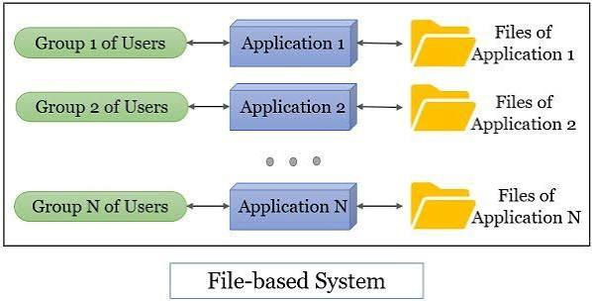
1. File-Based Systems
Data is stored in text files (e.g., TXT or CSV)
Limitations:
Separation & isolation of data
Duplication of data
Program-data dependence
Incompatible file formats

Slide 3
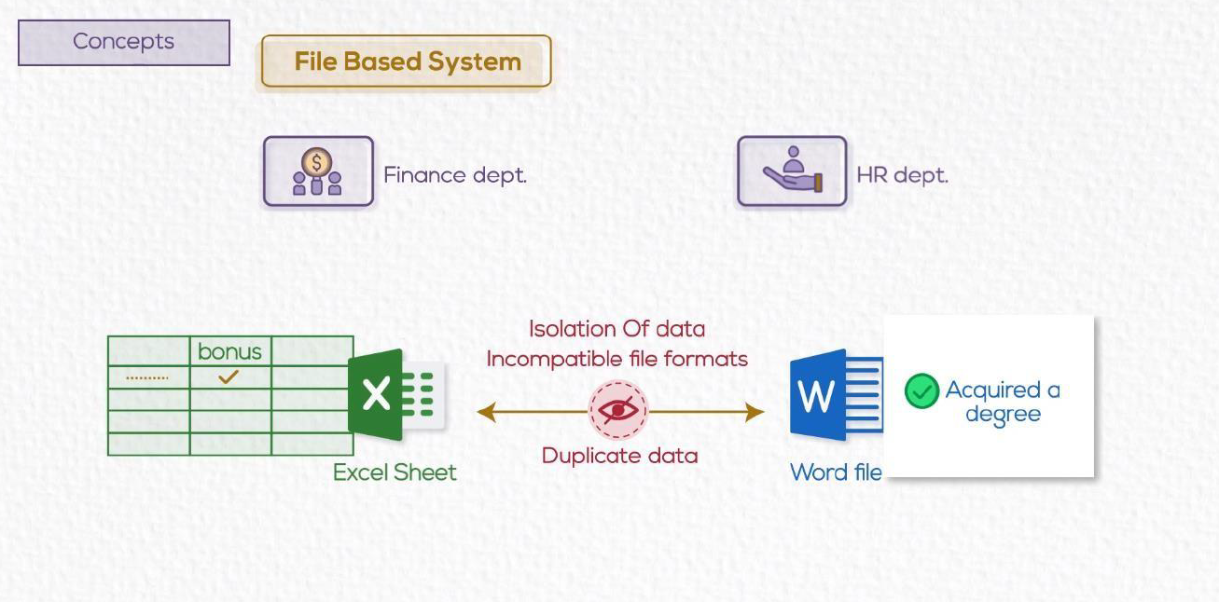

Slide 4
2. What is a Database?
A structured system to store and manage data electronically
Allows for: saving - updating - searching - deleting
Different types of databases handle data in different ways

Slide 5
Database vs DBMS vs Database System
Database:
A collection of organized data.
DBMS (Database Management System):
Software that allows users to interact with the database.
Examples: MySQL, MongoDB, Oracle DBMS, etc.
Database System:
The DBMS software together with the data itself. Sometimes, the applications are also included. (Software + Database)

Slide 6
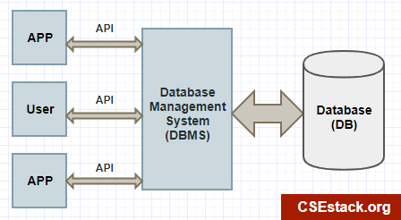

Slide 7
4. Advantages of Database Systems(BDMS)
Controlling Redundancy:
Restricting Unauthorized Access:
Sharing data:
Avoids unnecessary data duplication
Multiple users can access the same data
Ensures secure data access
Enforcing Integrity Constraints:
Inconsistency can be avoided:
Providing Backup and Recovery:
Maintains accuracy and consistency
Prevents data mismatches
Ensures data can be restored after failure

Slide 8
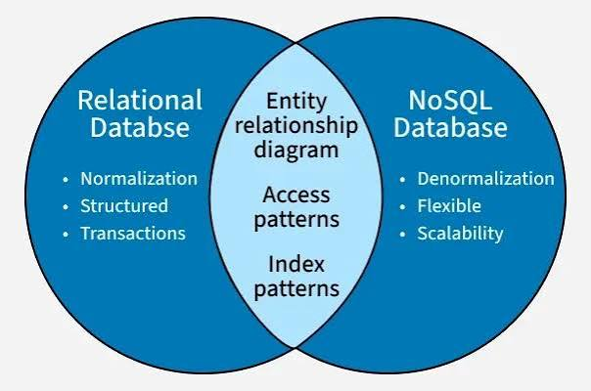
Relational vs Non-Relational Databases
Relational (SQL):
Non-Relational (NoSQL):
Based on tables (rows and columns)
Uses structured schema
Supports relationships between tables
Examples: MySQL, PostgreSQL, Oracle
Does not use tables
Flexible structure (documents, key-value, etc)
Commonly used in modern applications
Examples: MongoDB, Firebase, CouchDB

Slide 9
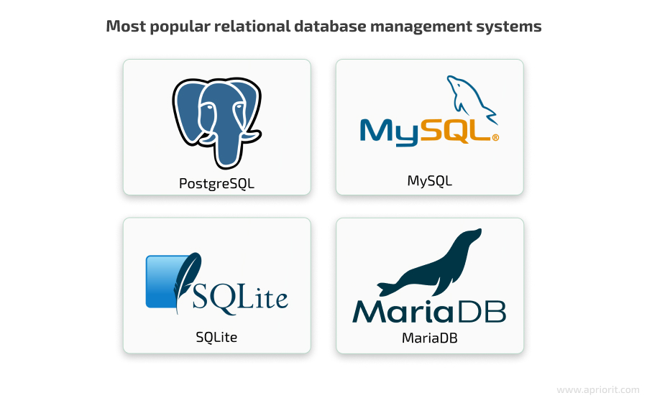
A Relational Database
is a type of database that stores data in tables (relations) made up of rows and columns. The tables are connected to each other using relationships, typically through primary keys and foreign keys, allowing data to be organized, managed, and retrieved efficiently using SQL (Structured Query Language).

Slide 10
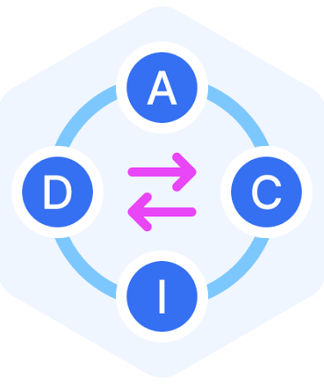
ACID Transactions
ensure reliable database transactions in Relational Databases:
A – Atomicity All or Nothing The entire transaction must complete, or none of it happens. If one part fails, the whole transaction is rolled back.
C – Consistency Valid State The database must remain in a valid state before and after the transaction, always following defined rules and constraints.
I – Isolation No Interference Multiple transactions can occur simultaneously without affecting each other. Each transaction runs as if it's alone in the system.
D – Durability Permanent Changes Once a transaction is committed, the changes are permanent, even in the case of a crash or power failure.

Slide 11
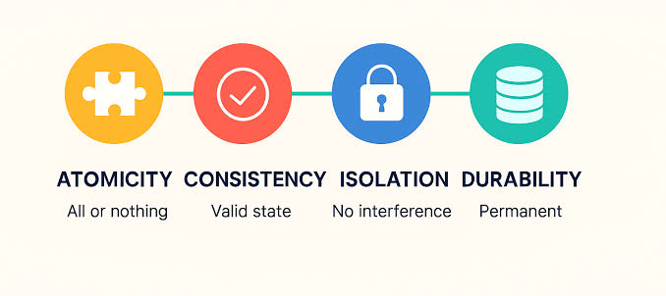

Slide 12
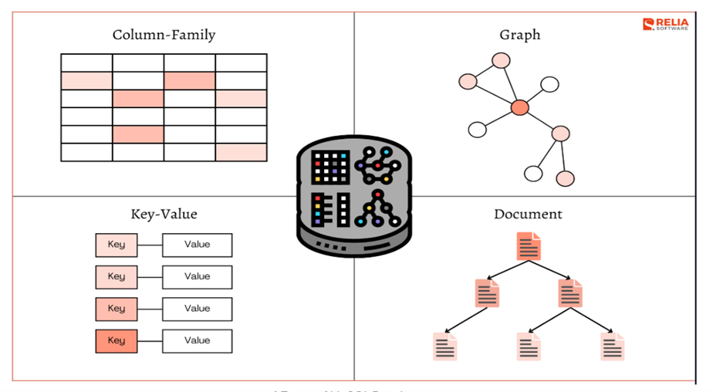
BASE Model (used in NoSQL systems)
Many NoSQL databases use a BASE model instead of strict ACID compliance, focusing more on flexibility and performance.
BA – Basically Available
The system guarantees availability, even if parts of it fail.
S– Soft State
The system’s state may change over time, even without input (due to sync delays).
E – Eventually Consistent
The system will reach a consistent state eventually, not instantly.

Slide 13
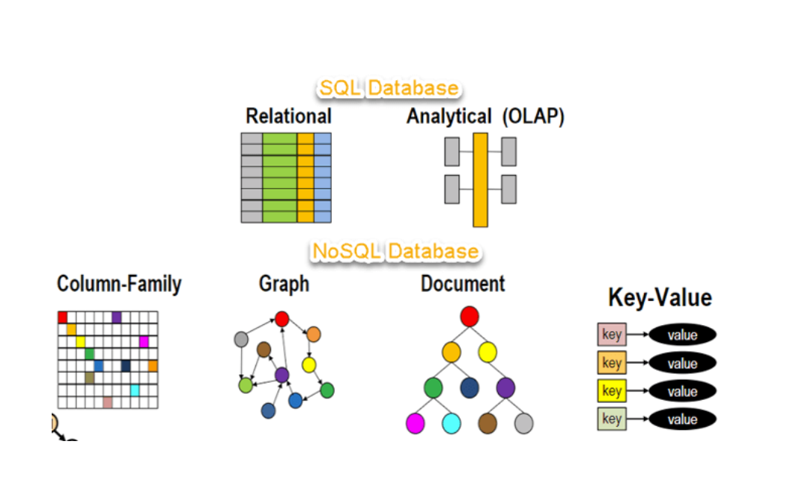

Slide 14
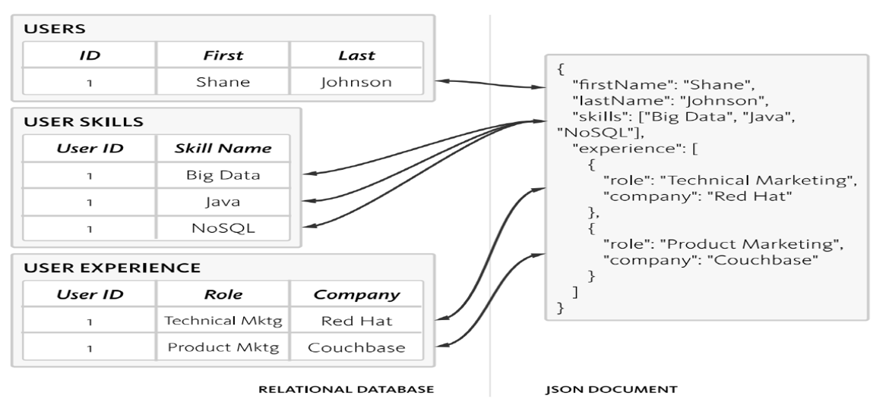

Slide 15


